Slide 1
PREDICTION OF INCIDENCE AND
SEVERITY OF COFFEE LEAF RUST
Under the guidance of
Prof. Chiranjit Mukhopadhyay
By:
Amitabh Gunjan
Organisation:
eka Analytics
Department of Management Studies 5th April 2018 Indian Institute of Science

Slide 2
AGENDA
Introduction
Recap
Problem Statement
Data Description
VAR Modelling
Machine learning models – Motivation
RNN and LSTM
Literature review
LSTM implementation
Hyperparameters tuning – Grid search
Comparison of accuracy
Road ahead
Department of Management Studies 5th April 2018 Indian Institute of Science

Slide 3
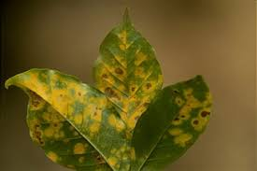
INTRODUCTION
Leaf rust:
caused by a fungus called Hemileia Vastatrix.
Leads to premature fall of infected leaves.
Symptoms include appearance of spots on the upper leaf surface of plants.
Impacts:
Decreased quality and quantity of yield produced.
Increased cost to control and combat the disease.
Key definitions:
Rust incidence: (Number of infected leaves/Total number of leaves observed)*100
Severity: (Sum of severity ratings of all observed leaves/(5* Total number of leaves observed))*100
Scale for grading of severity ranges from 0 to 5.
Department of Management Studies 5th April 2018 Indian Institute of Science

Slide 4
PROBLEM STATEMENT
DATA DESCRIPTION
Category | Description
Weather conditions | Average maximum temperature(◦c) Average minimum temperature(◦c) Relative humidity Sunshine(hours) Rainfall(mm)
Leaf rust | Population infected: (Number of plants infected/Total number of plants observed)*100 Rust incidence: (Number of infected leaves/Total number of leaves observed)*100 Severity: ((Sum of severity ratings of all observed leaves/5)* Total number of leaves observed)*100 *Scale for grading of severity ranges from 0 to 5.
Client of EKA analytics has coffee plantations which face the severe problem of leaf rust that leads to huge losses of yield.
The client had initiated an experimental trial on one of the plantations and recorded leaf rust incidence and severity on fortnightly basis over the span of 8 years.
They want forewarning model on the outbreak of disease.
The aim of this project is to predict coffee leaf rust incidence and severity.
Department of Management Studies 5th April 2018 Indian Institute of Science

Slide 5
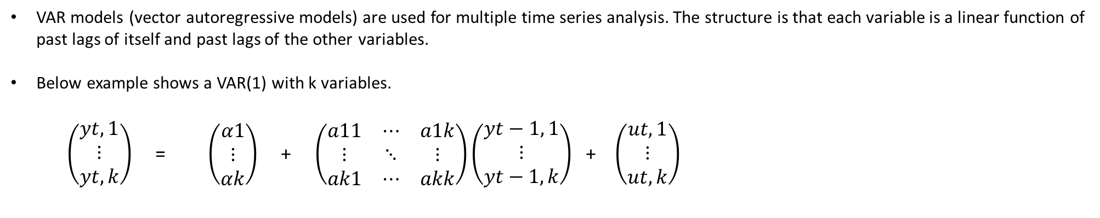
VAR MODELING
VAR models (vector autoregressive models) are used for multiple time series analysis. The structure is that each variable is a linear function of past lags of itself and past lags of the other variables.
Below example shows a VAR(1) with k variables.
$\left(\begin{aligned}yt,1 \\ ⋮ \\ yt,k\end{aligned}\right)$ = $\left(\begin{aligned}α1 \\ ⋮ \\ αk\end{aligned}\right)$ + $\left(\begin{matrix}a11 & ⋯ & a1k \\ ⋮ & ⋱ & ⋮ \\ ak1 & ⋯ & akk\end{matrix}\right)\left(\begin{aligned}yt−1, 1 \\ ⋮ \\ yt−1, k\end{aligned}\right)$ + $\left(\begin{aligned}ut,1 \\ ⋮ \\ ut, k\end{aligned}\right)$
In this case k = 8.
Order selection: Used the Schwartz criteria for VAR order selection which gave the order of the lag to be 1.
Department of Management Studies 5th April 2018 Indian Institute of Science

Slide 6
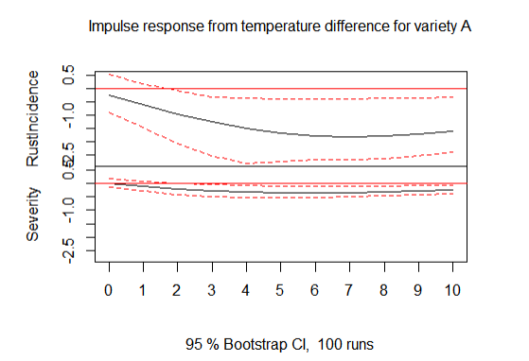
Department of Management Studies 5th April 2018 Indian Institute of Science

Slide 7
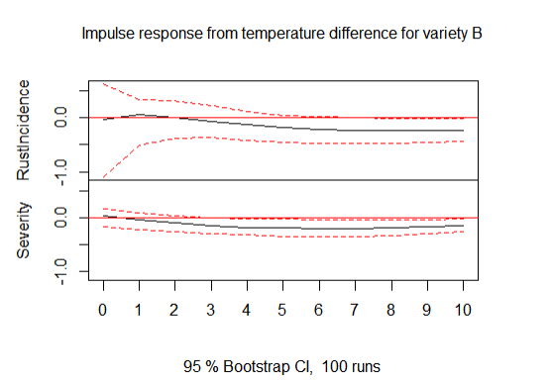
Department of Management Studies 5th April 2018 Indian Institute of Science

Slide 8
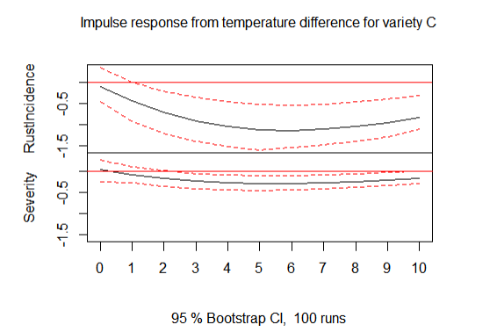
Department of Management Studies 5th April 2018 Indian Institute of Science

Slide 9
Machine learning models – Motivation:
There are numerous research papers that focus on prediction of coffee leaf rust using many machine learning techniques.
Some of the techniques that have been used are
Neural networks
Support vector machines
K-nearest neighbours
Logistic regression
VAR | RNN
It is a linear model | It can learn non-linear patterns in the data.
Number of lags need to be found | Number of lags need not be found.
Department of Management Studies 5th April 2018 Indian Institute of Science

Slide 10
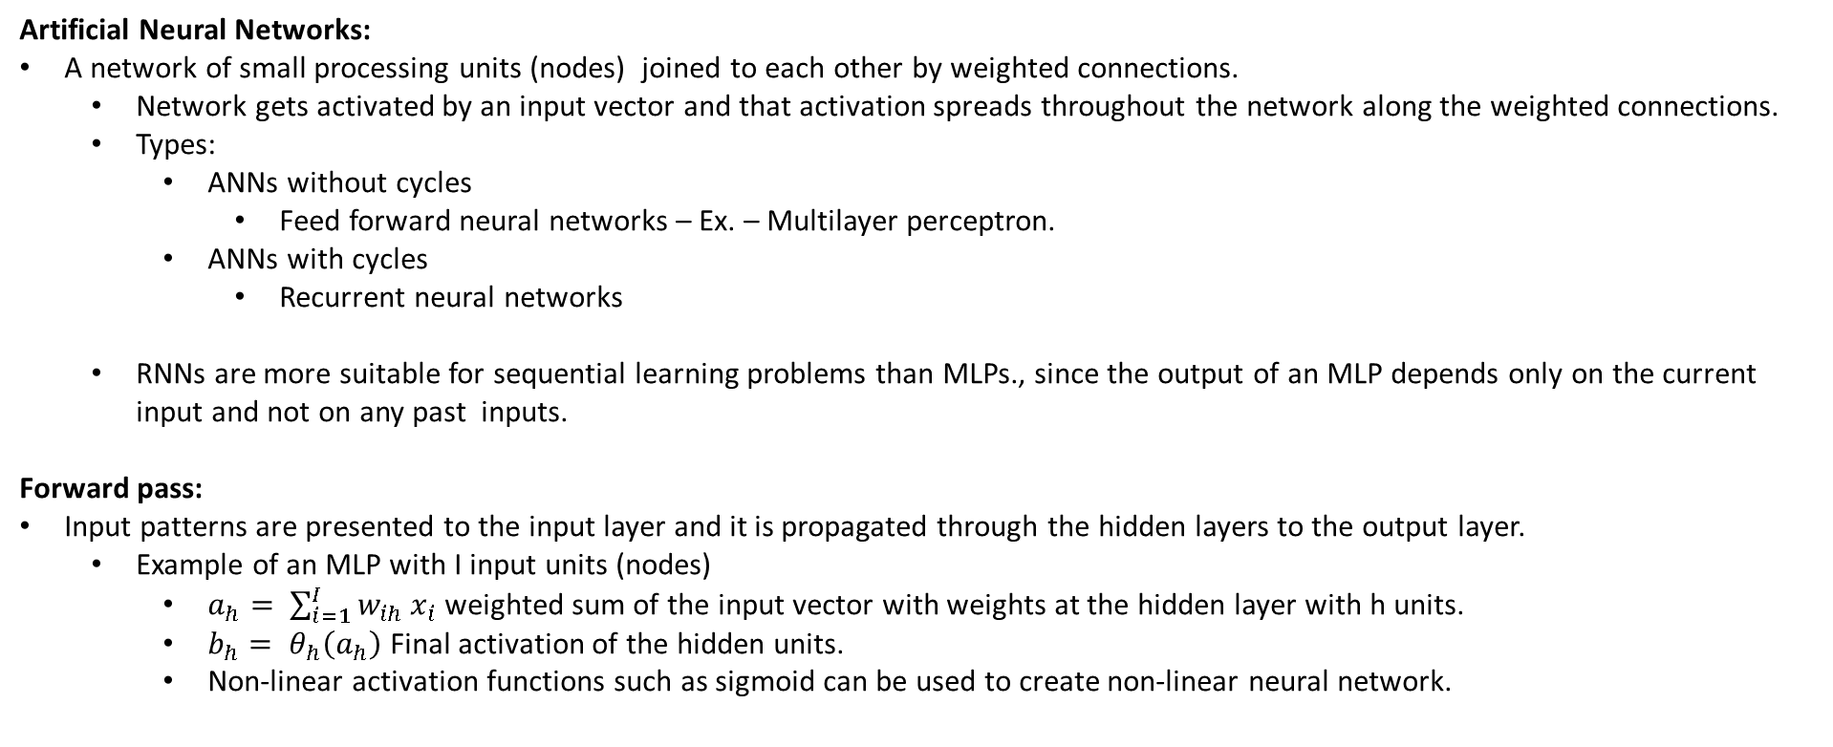
Artificial Neural Networks:
A network of small processing units (nodes) joined to each other by weighted connections.
Network gets activated by an input vector and that activation spreads throughout the network along the weighted connections.
Types:
ANNs without cycles
Feed forward neural networks – Ex. – Multilayer perceptron.
ANNs with cycles
Recurrent neural networks
RNNs are more suitable for sequential learning problems than MLPs., since the output of an MLP depends only on the current input and not on any past inputs.
Forward pass:
Input patterns are presented to the input layer and it is propagated through the hidden layers to the output layer.
Example of an MLP with I input units (nodes)
$a_{h}= \sum_{i=1}^{I}{w_{ih}}x_{i}$ weighted sum of the input vector with weights at the hidden layer with h units.
$b_{h}= θ_{h}\left(a_{h}\right)$ Final activation of the hidden units.
Non-linear activation functions such as sigmoid can be used to create non-linear neural network.
Department of Management Studies 5th April 2018 Indian Institute of Science

Slide 11
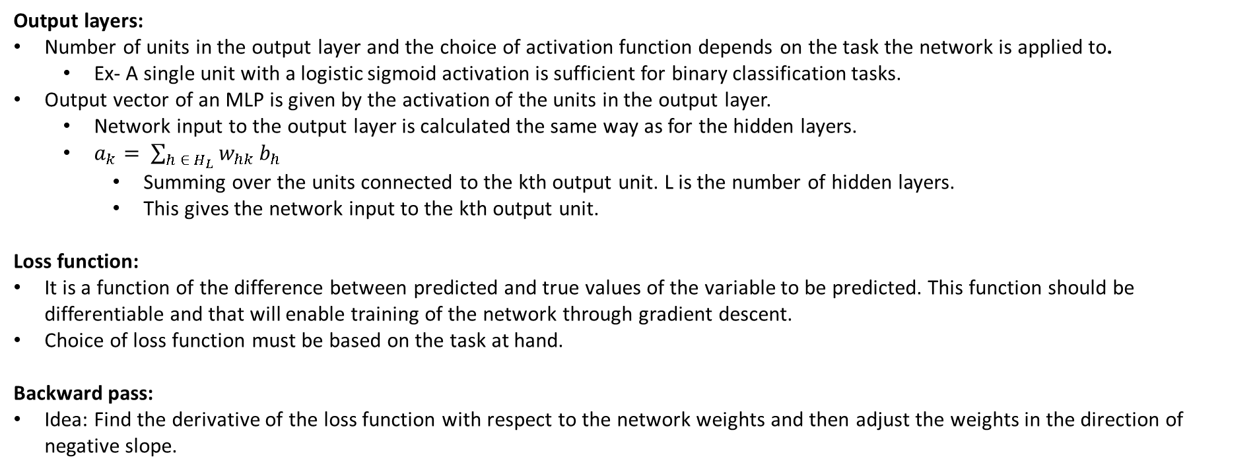
Output layers:
Number of units in the output layer and the choice of activation function depends on the task the network is applied to.
Ex- A single unit with a logistic sigmoid activation is sufficient for binary classification tasks.
Output vector of an MLP is given by the activation of the units in the output layer.
Network input to the output layer is calculated the same way as for the hidden layers.
$a_{k}= \sum_{h ∈ H_{L}}{w_{hk}}b_{h}$
Summing over the units connected to the kth output unit. L is the number of hidden layers.
This gives the network input to the kth output unit.
Loss function:
It is a function of the difference between predicted and true values of the variable to be predicted. This function should be differentiable and that will enable training of the network through gradient descent.
Choice of loss function must be based on the task at hand.
Backward pass:
Idea: Find the derivative of the loss function with respect to the network weights and then adjust the weights in the direction of negative slope.
Department of Management Studies 5th April 2018 Indian Institute of Science

Slide 12
LITERATURE SURVEY
Journal | Title & Author | Description | Dataset | Techniques used/ referred
arXiv library | A Critical Review of Recurrent Neural Networks for Sequence Learning - Zachary C. Lipton, John Berkowitz, Charles Elkan | Have provided a review of the state of the art together with a historical perspective of recurrent neural networks. | None | RNN
 | Supervised sequence labelling with recurrent neural networks – Alex Graves | Book on sequence labelling using RNN and LSTM |  | RNN, LSTM
arXiv library | Recurrent Neural Network Regularization – Wojciech Zaremba et. al. | Presented dropout regularization for Recurrent Neural Networks. | Penn Tree Bank Dataset. | RNN
arXiv library | LSTM: A Search Space Odyssey – Klaus Greff et. al. | Large scale analysis of eight LSTM variants on three tasks. Guidelines for hyperparameter tuning. | TIMIT dataset IAM online dataset JSB chorales dataset | LSTM
Department of Management Studies 20th Feb 2018 Indian Institute of Science

Slide 13
Recurrent neural networks:
We obtain recurrent neural networks when we relax the condition of no cyclic connections in the feed forward neural networks.
An MLP can map from input to output vectors while an RNN can map from entire history of previous inputs to each output.
Forward pass:
It is the same as that of MLP except that activations arrive at the hidden layer from both the current external input and the hidden layer activation from previous timestep.
Ex -
Department of Management Studies 5th April 2018 Indian Institute of Science

Slide 14
Network training:
Gradient descent:
Take a small fixed-size step in the direction of negative error gradient of the loss function:
Suffers from a major problem of being stuck in a local minima.
To address that a momentum term can be added that adds inertia to the motion of the algorithm through weight space.
Generalisation:
The loss function is defined over the training data set but the real goal is to minimise the loss on test data. This issue is referred to as generalisation.
In general, larger the training set larger the generalisation.
Method for improving generalisation – regularization.
Input representation:
Choosing a suitable representation of data is of vital importance for a machine learning task.
Neural networks, however are relatively robust to the choice of input representation.
Only requirement:
Dataset must contain all the relevant information to predict the output
Choice of input representation is something of a black art.
Weight initialization:
Gradient descent algorithms for neural networks require small, random, initial values for weights. Ex- uniform distribution [-0.1, 0.1]
Department of Management Studies 5th April 2018 Indian Institute of Science

Slide 15
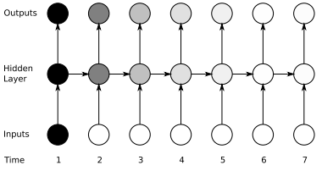
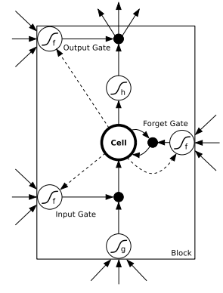
RNN vs. LSTM:
RNN have the ability to use contextual information when mapping between input and output sequences.
But in practice they fail to do so!
The problem is that the influence of a given input on the hidden layer, and therefore on the network output, blows or decays exponentially as it cycles around the network’s recurrent connections. Also called vanishing gradient problem.
LSTM does away with the problem.
LSTM architecture:
Consists of a set of recurrently connected subnets known as memory blocks.
RNN and LSTM are the same except that the summation units in the hidden layer are replaced by memory blocks.
The multiplicative gates allow LSTM memory cells to store and access information over long periods of time, thereby mitigating the vanishing gradients problem.
Ex- as long as the input gate remains closed the activation will not be overwritten by the new inputs arriving in the network.
Department of Management Studies 5th April 2018 Indian Institute of Science

Slide 16
Hyperparameters:
These are the hyperparameters to be tuned in an LSTM:
Learning rate
Momentum
Number of units in hidden layer
Gradient descent optimizer
Activation function
Epochs
Batch size
Weight initializer
Dropout rate
Many papers mentioned that dropout is not useful in regularizing recurrent neural networks. On the contrary dropout was useful in modelling variety C rust incidence.
Briefly describe their importance.
Department of Management Studies 5th April 2018 Indian Institute of Science

Slide 17
Notes on tuning:
There is no apparent hyperparameter interactions structure. []
For all practical purposes the hyperparameters can be treated approximately independent.[]
Approach:
Number of epochs and batch size was tuned first using grid search.
Then learning rate and momentum were tuned using grid search
Then network size, activation function, weight initializer was tuned. (not in order)
Final selection of optimal hyperparameters was done after final tuning by hand.
Department of Management Studies 5th April 2018 Indian Institute of Science

Slide 18
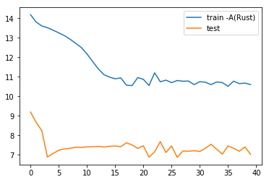
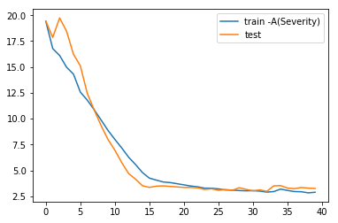
Variety A:
loss
loss
Number of epochs
Number of epochs
Department of Management Studies 5th April 2018 Indian Institute of Science

Slide 19
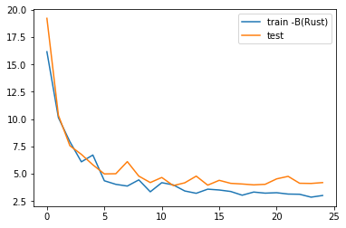
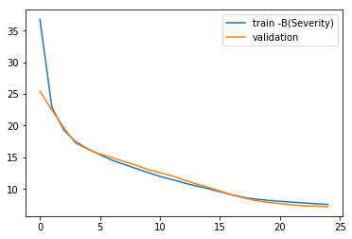
Variety B:
loss
loss
Number of epochs
Number of epochs
Department of Management Studies 5th April 2018 Indian Institute of Science

Slide 20
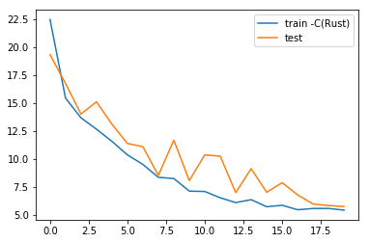
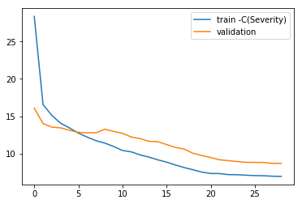
Variety C:
loss
loss
Number of epochs
Number of epochs
Department of Management Studies 5th April 2018 Indian Institute of Science

Slide 21
Comparison of accuracy:
Department of Management Studies 5th April 2018 Indian Institute of Science

Slide 22
Road ahead:
Department of Management Studies 5th April 2018 Indian Institute of Science

Slide 23
References:
Lütkepohl, H. (2007) New Introduction to Multiple Time Series Analysis , Springer.
http://colah.github.io/posts/2015-08-Understanding-LSTMs/
Department of Management Studies 5th April 2018 Indian Institute of Science

Slide 24
Thank You!
Department of Management Studies 5th April 2018 Indian Institute of Science

Slide 25
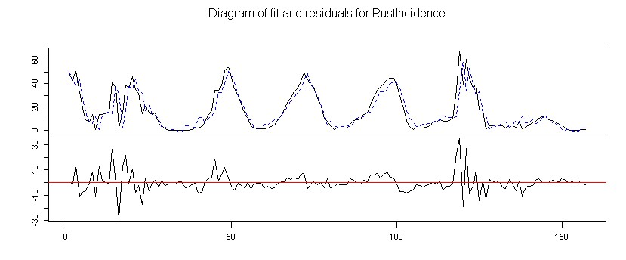
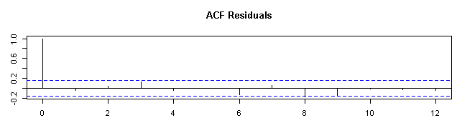
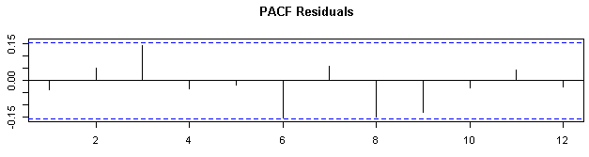
Department of Management Studies 5th Apr 2018 Indian Institute of Science

Slide 26
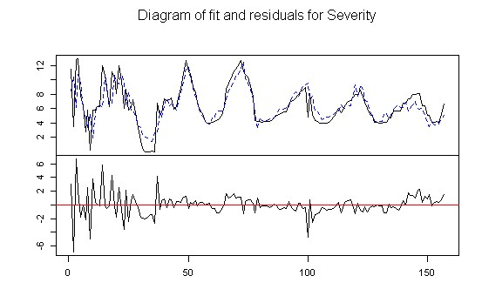
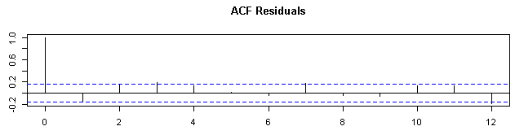
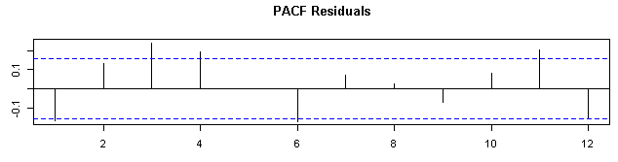
Department of Management Studies 5th Apr 2018 Indian Institute of Science

